Slide 1
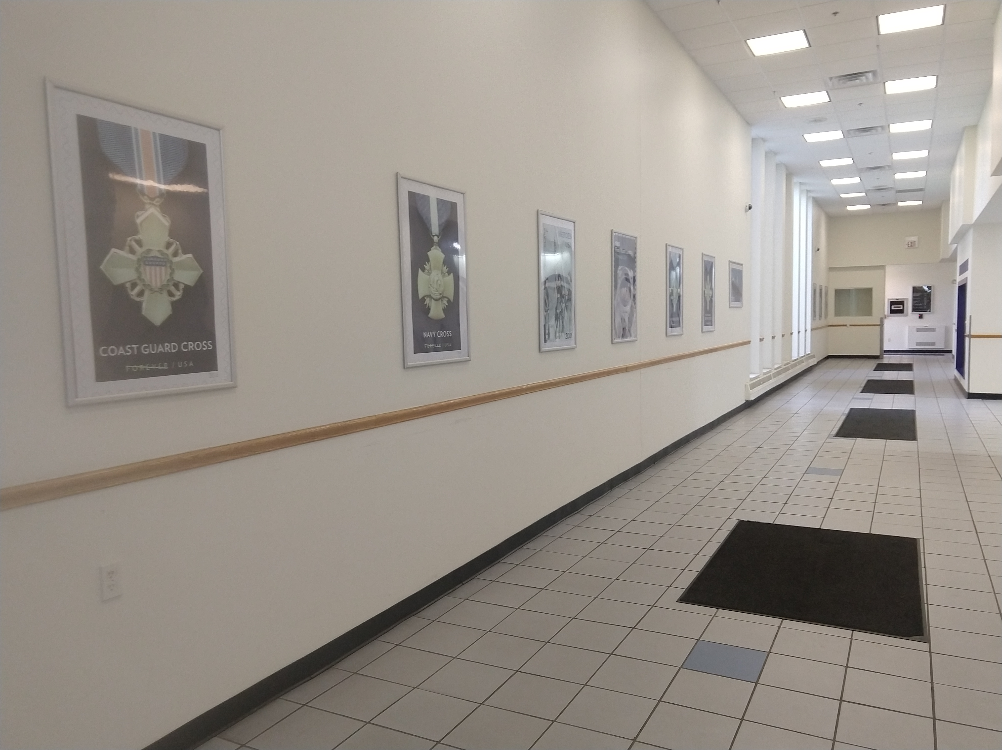
2021 Ohio 1
Mailing Super Stars
Whether you prepare your own mail, or use a Mail Service Provider, you are a Mailing Super Star. In January 2022, you can tell the world just how amazing you are. Submit your best mailpiece to be displayed in the Cleveland Main Post lobby and on the PCC websites. This is a great opportunity to educate people about your organization and the services that you provide and maybe win a trophy!

Slide 2
Friendly Competition
Must be a member of an Ohio 1 PCC.
Three sizes divisions. Small, Medium, Large. Mailers can choose what division they want to enter but can only submit one entry.
Piece must have been mailed in the Ohio 1 area during 2021.
Entries will be displayed in Cleveland’s Main Post Office lobby and featured on the PCC websites.
QR code in lobby will take customers to PCC website. Voting will be done online. Postal employees are not eligible to vote.
One vote for each size division.

Slide 3
Public Education
                The lobby of Cleveland Main post office gets high traffic volume. Mailers come in to make deposits. The general public comes in to make stamp purchases or check their PO Box. That makes this location ideal for promoting awareness of our Mailing Superstars.
                There will be an educational section with information about the Postal Customer Councils, Postal Workshare discounts, and Mail Service Providers.

Slide 4
Submission Details
Submissions will be accepted from January 3, 2022 until January 18, 2022.
You may drop off your entry in person at 2400 Orange Ave Cleveland OH 44101.
Drop off locations are the Cleveland BMEU or the Business Service Network office.
You can also mail your entry to:
USPS BSN
2400 Orange Ave RM 23
Cleveland OH 44101. Tracking is recommended.
Your submissions will be displayed January 24, 2022 until February 23, 2022 for voting. Vote for your favorites, and plan to attend the Awards ceremony either in person or via Zoom. Details on the Award ceremony coming soon.

